Slide 1

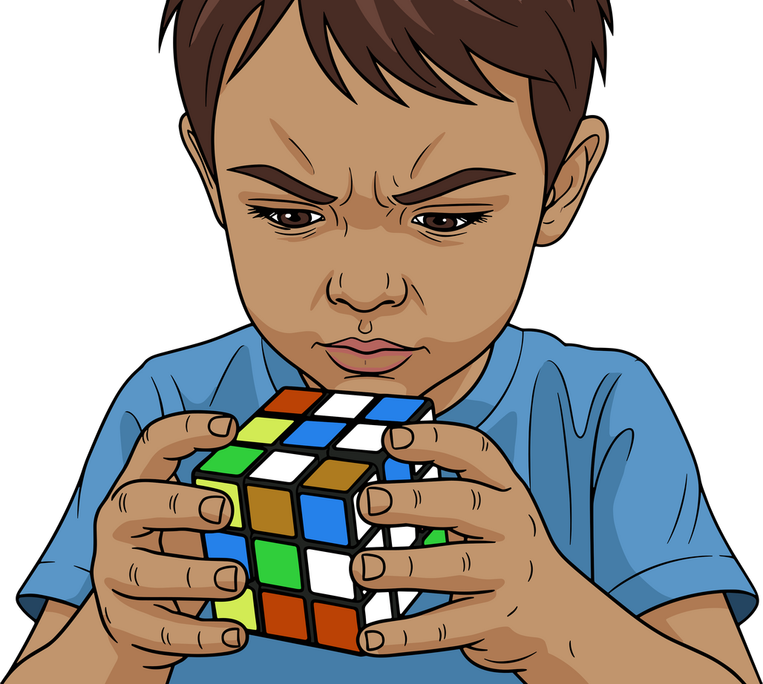

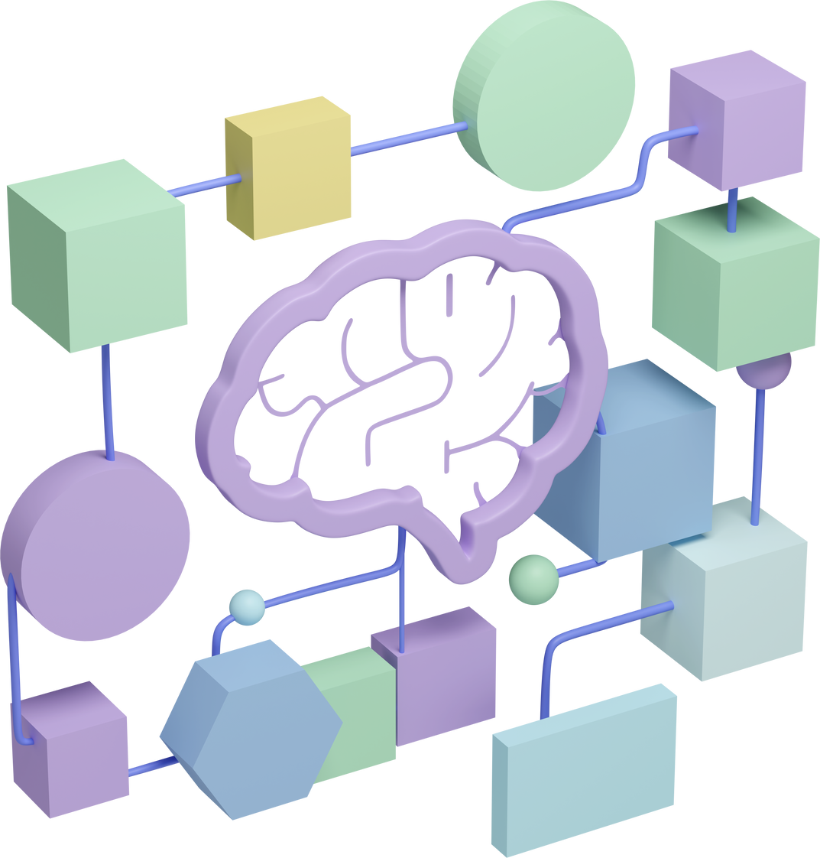
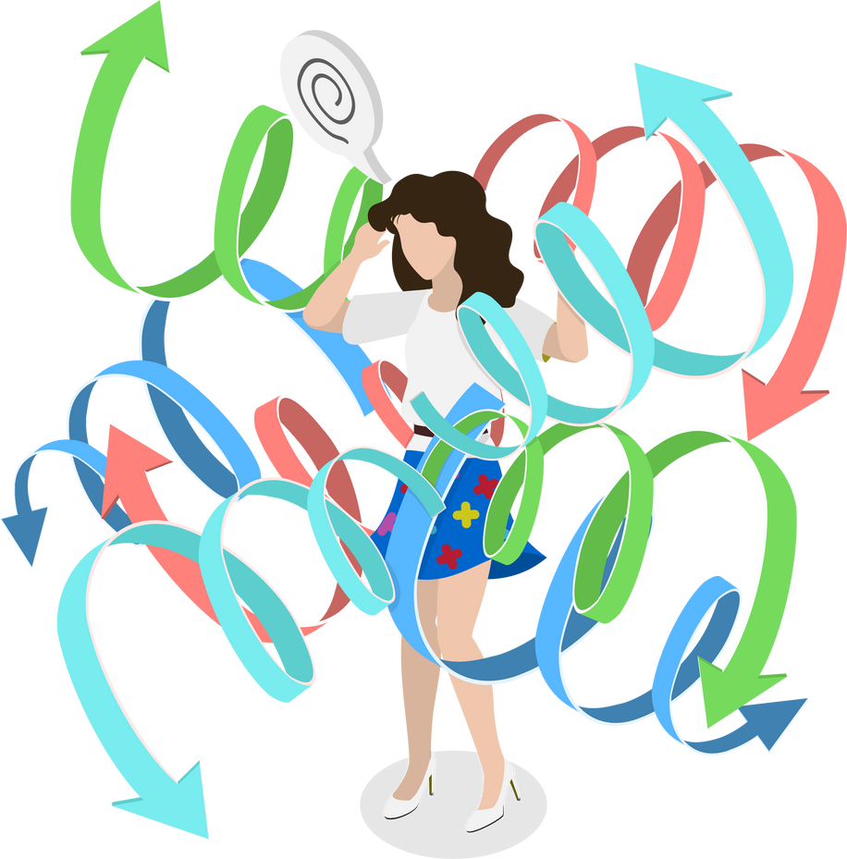

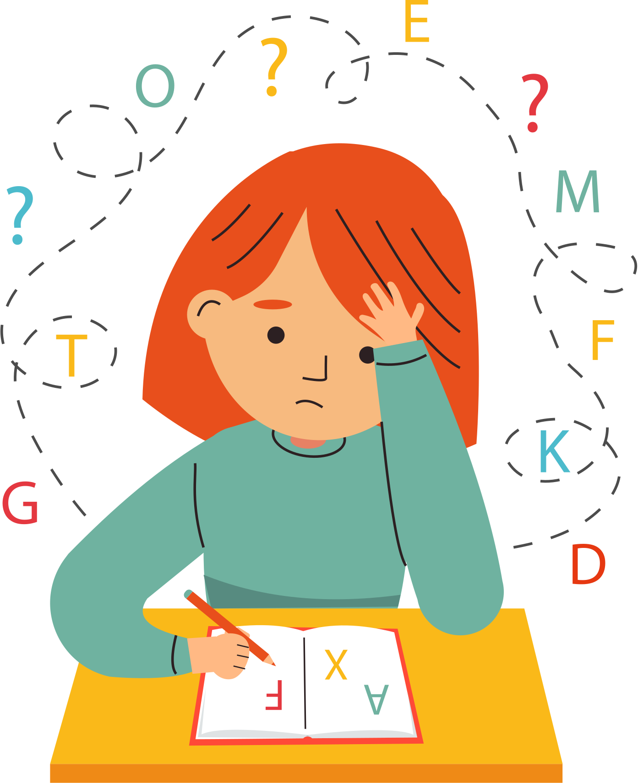
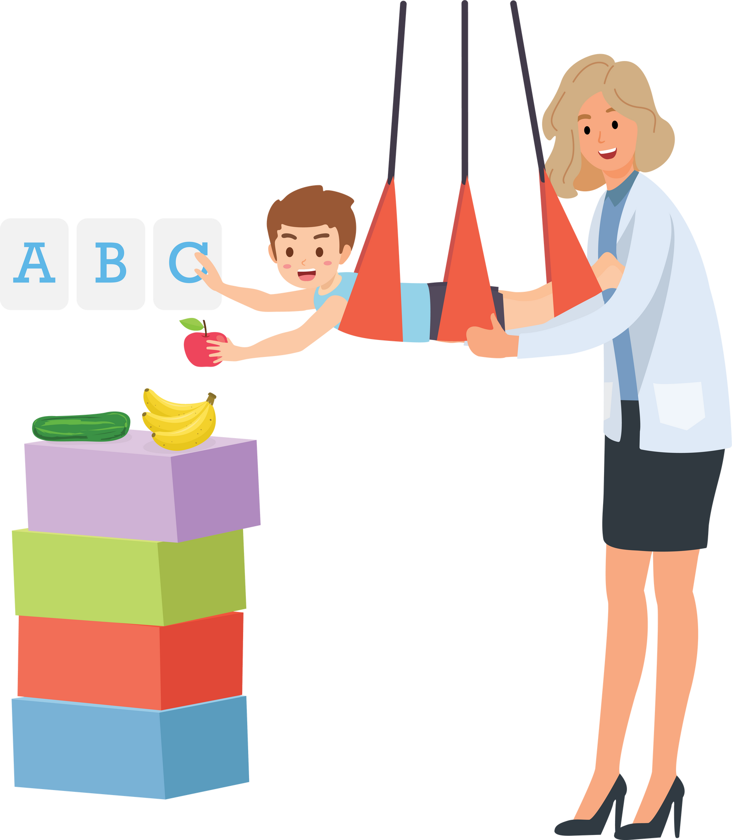
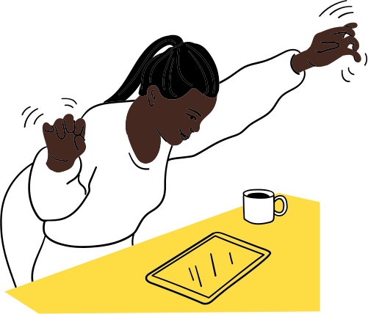
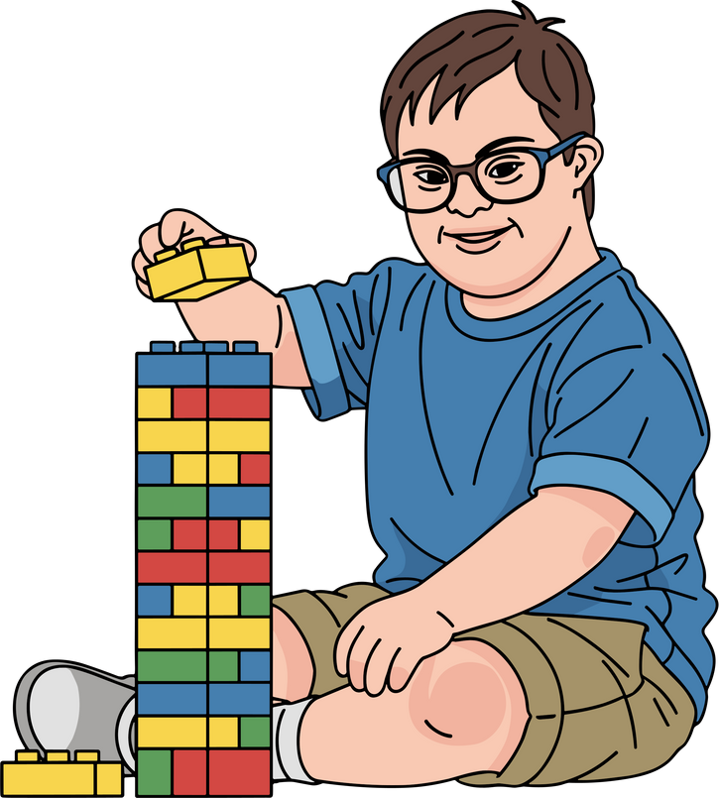
My Mind Matters
Notes:
Some brains feel things more strongly, notice more things, or get overwhelmed more quickly. That’s not wrong. It just means they need different help.
Not everyone experiences noise, change, waiting, or emotions the same way
Some children need more movement, more quiet, more time, more help
Some brains are like sports cars - very fast and very powerful, but need careful steering.
Some brains are like sponges - they soak up every sound, light, and feeling.
Some brains find sitting still very hard because their body wants to move.
Some brains feel emotions like a volume knob turned up high.

Slide 2
“Mental health is about how our mind feels.”
Just like we look after our teeth, our eyes, our skin and our organs, we need to look after our mind.
Our mind and body work together to help us:
· Feel safe
· Feel calm
· Feel content
· Deal with worries
· Deal with problems
Notes:
content being a synonym for happy
other words to give the children
content
peaceful
satisfied
comfortable
at ease
cheerful
safe
proud
grateful
connected
valued
Please create a wordbank of these in KS1/KS2

Slide 3

We can only let our light shine fully when our mind is healthy. Even when our bodies are poorly, we can shine our light.

Slide 4
“Emotional wellbeing means our feelings are looked after.”
When our feelings are looked after, we can:
Learn better
Be kind
Make friends
Try new things
Feel brave
Notes:
Feeling like we belong is one of the most important ways to keep our minds healthy.
These things still look different for different people

Slide 5
Feelings change (and that’s normal)
Feelings come and go
No feeling is “bad”
Big feelings don’t mean you’re a bad person
You can feel two feelings at once
Notes:
Feeling loved and supported keeps our minds healthy.
Some brains feel emotions like a volume knob turned up high.

Slide 6
Talking* helps your brain
Worries grow when kept inside
Saying* things out loud makes them smaller
Asking for help is brave, not weak
Adults are there to help with big feelings
*not everybody communicates by talking
Notes:
Feeling loved and supported keeps our minds healthy.
Not everyone is able to do that, talking can be replaced with communicating. Children, for the most part, in our school can talk about them. They might communicate it in different ways.
e.g.
Pointing to a picture of ‘sad’ or ‘angry’
Drawing a scribble for frustration

Slide 7
Thoughts are not always facts
“Your brain tells stories. Not all of them are true.”
“Nobody likes me”
“I’m terrible at everything”
“I always get in trouble”
Notes:
Feeling loved and supported keeps our minds healthy.

Slide 8


Thoughts are not always facts
Evidence
Notes:
Feeling loved and supported keeps our minds healthy.

Slide 9
How to look after your mental health
Sleep
Food
Movement
Playing
Time outside
Being with people you trust
Doing things you enjoy
Special exercises
Special interests
Notes:
Feeling loved and supported keeps our minds healthy.

Slide 10

What does the bible say?
Pray/talk* (to God)
Be specific your feelings
Practice gratitude
Focus thoughts on what is true, good, lovely (v.8)
Philippians 4:8
Paul said:
Don’t be consumed by anxiety
Pray
Be thankful
Receive God’s peace
Notes:
Feeling loved and supported keeps our minds healthy.

Slide 11


What to do when feelings feel too big
Who can I talk* to?
What helps me calm down?
Where is my safe space?
What can I do with my body?
* Share with
Notes:
Feeling loved and supported keeps our minds healthy.

Slide 12

My Safe Place
“I feel safe with…”
“These people help me feel I belong…”
Notes:
Safety reduces worry
Calm helps thinking and learning
Everyone needs a place where they feel secure
“Having a safe place helps our mind feel peaceful.”

Slide 13
My Safe Place
“I know I belong because…”
“I feel like I belong when…”
“The people who help me feel that I belong are …”
Notes:
Safety reduces worry
Calm helps thinking and learning
Everyone needs a place where they feel secure
“Having a safe place helps our mind feel peaceful.”

