Slide 1
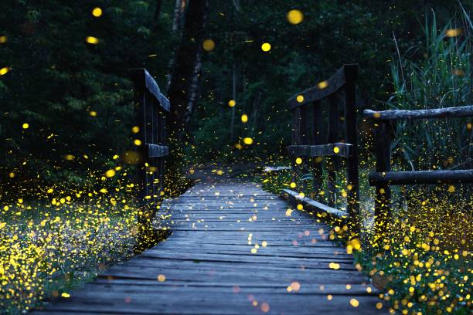
Notes:
Fireflies are small insects that can make their bodies light up in the dark.
Their light is not fire — it is a special glow they use to talk to each other.
Fireflies use their light to:
find friends
send messages
Fireflies are found in warm places around the world, especially:
near forests
around fields
close to rivers and wetlands
They like places where there are plants, water and clean air.

Slide 2
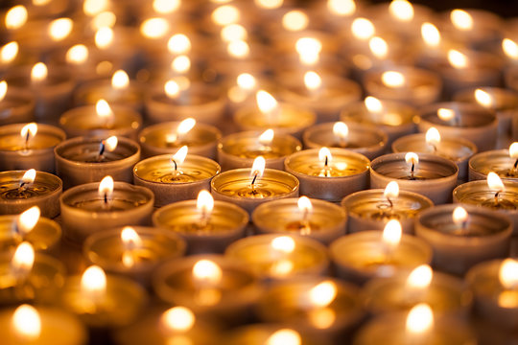

Slide 3


Slide 4
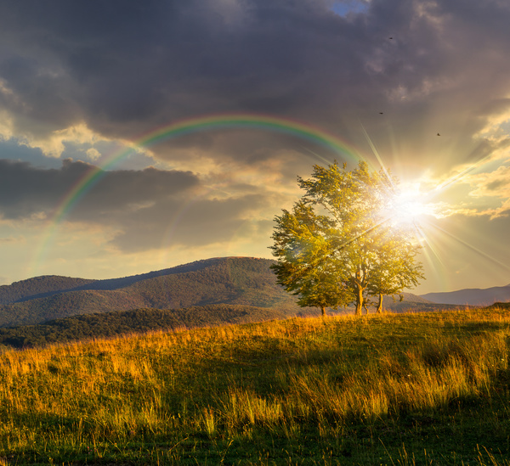

Slide 5
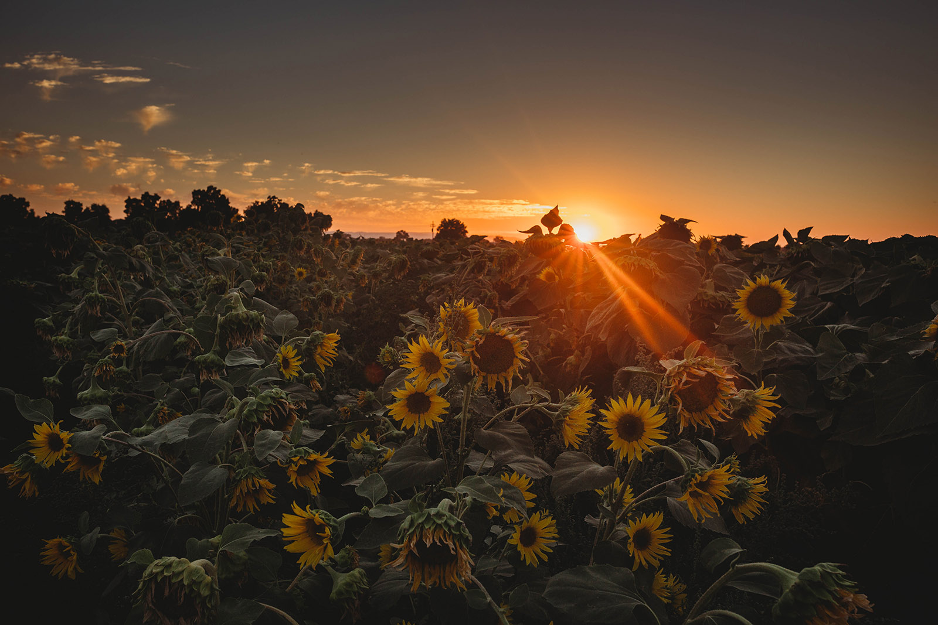

Slide 6
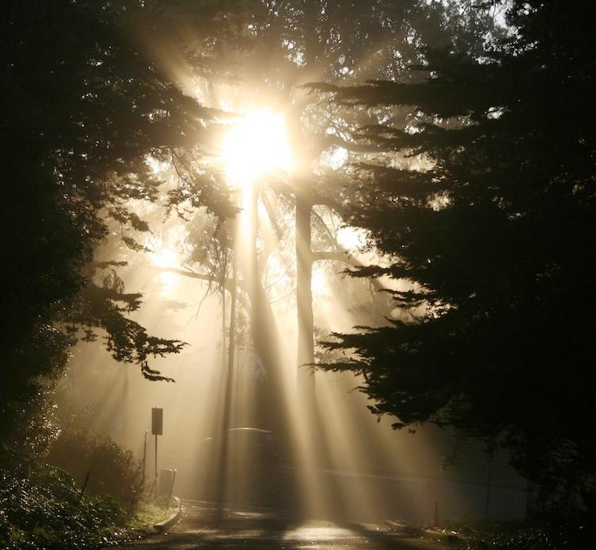
Notes:
Everyone has a light.
Lights look different — and that’s okay.
When we shine together, the world becomes brighter.

Slide 7
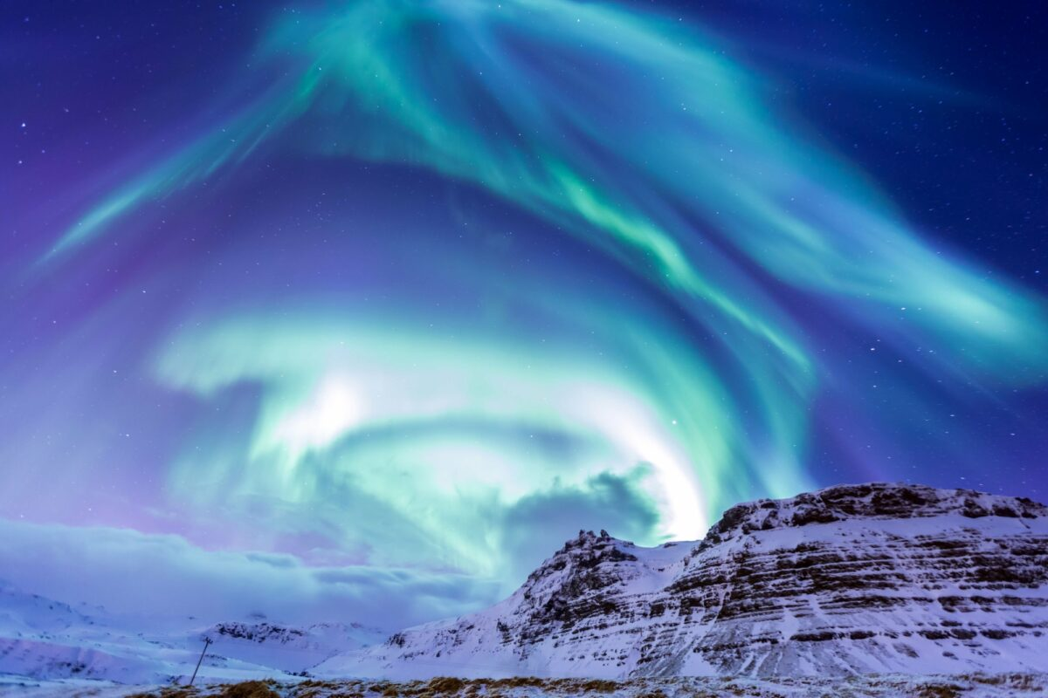
Notes:
Light often stands for:
kindness
hope
truth
love
When things feel dark or tricky, light helps us feel:
calmer
braver
less alone

Slide 8
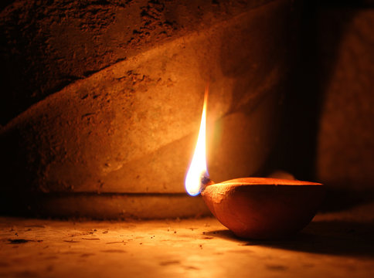
Notes:
Light helps us see where we are going.
It keeps us safe in the dark.
Light helps plants grow and keeps the world alive.
Even a small light can make a big difference in darkness.

Slide 9
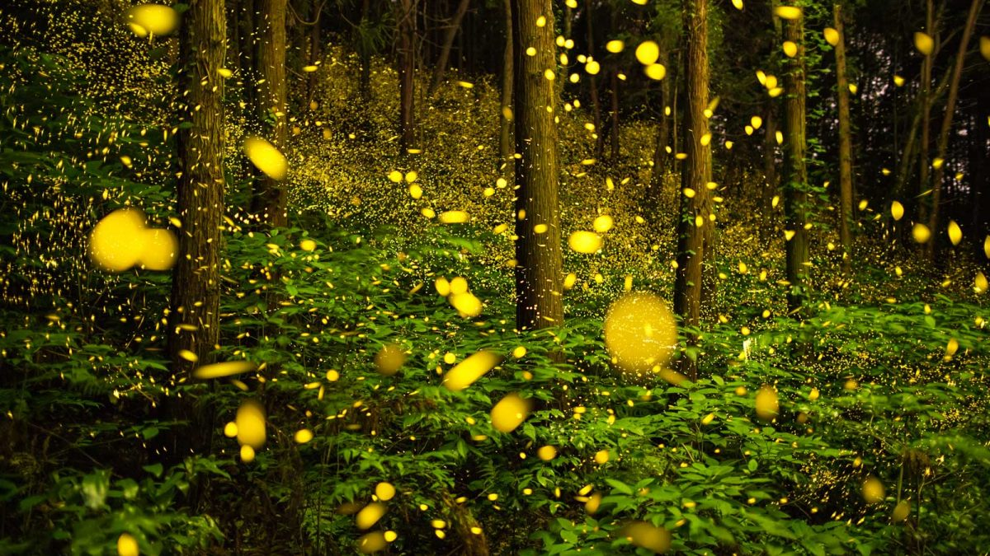
Notes:
Fireflies use their light to communicate.
Their light helps others find them.
Even though they are tiny, their light is easy to see.
This reminds us that you don’t have to be big or loud to shine.

Slide 10
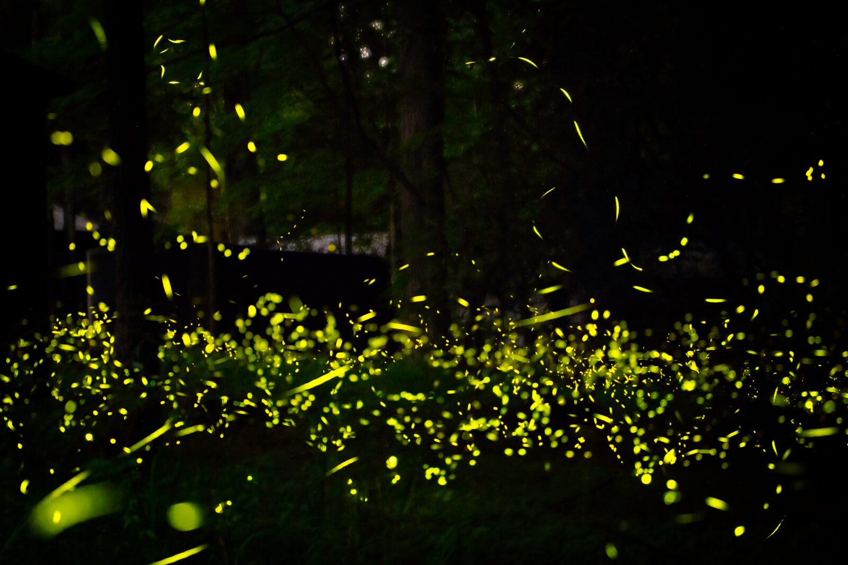

Slide 11
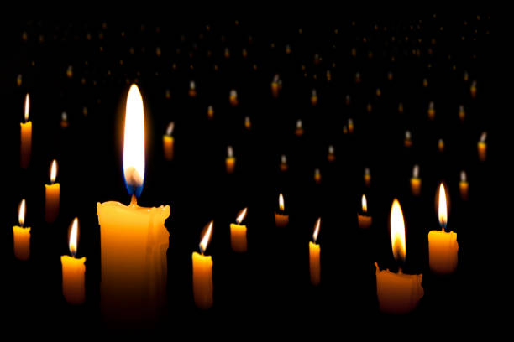

Slide 12
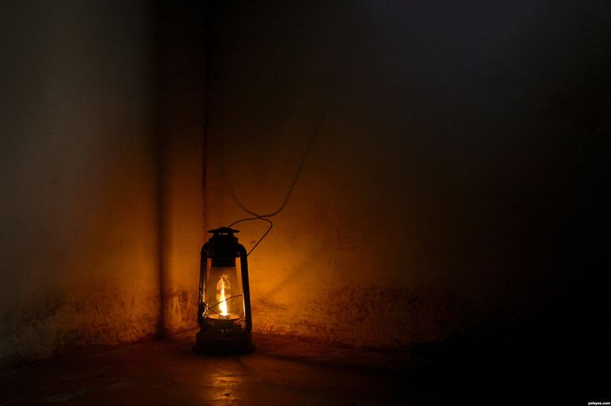

Slide 13
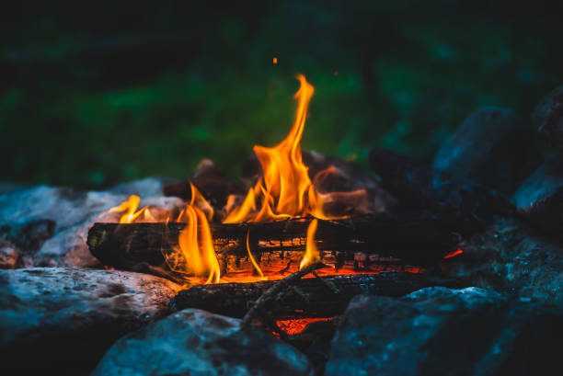

Slide 14


Slide 15
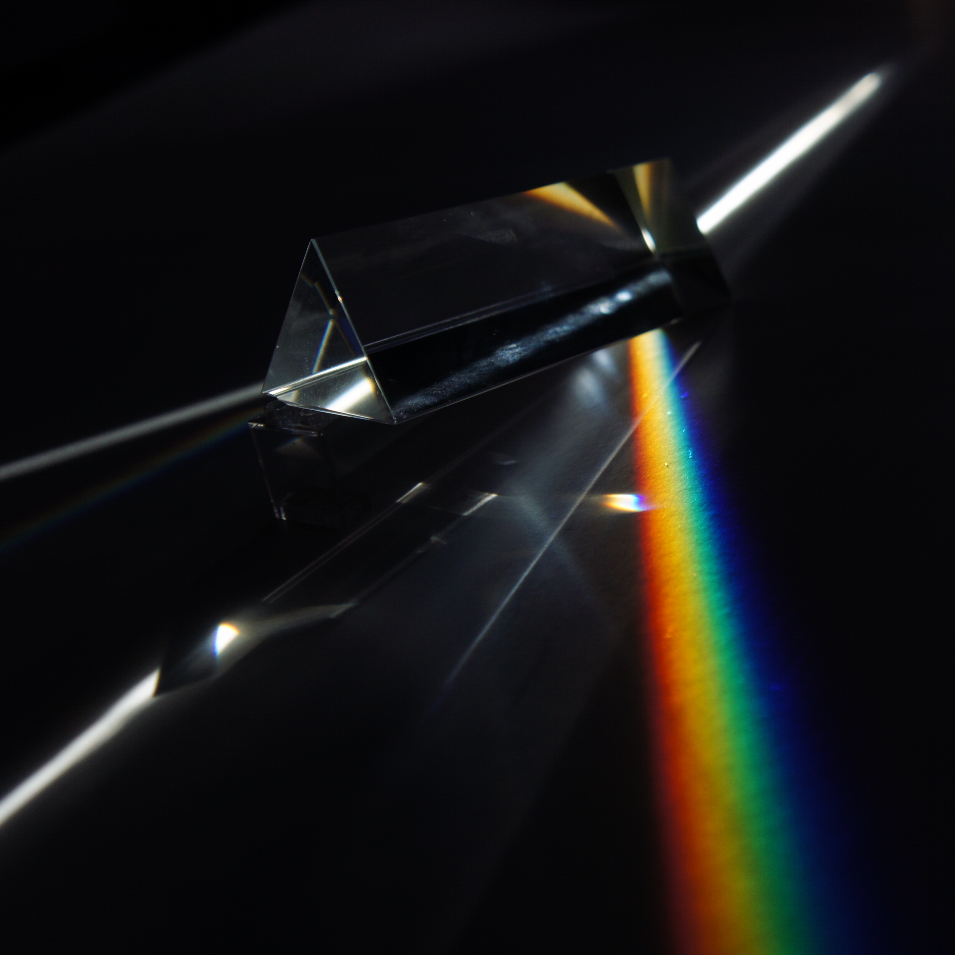

Slide 16


