Slide 1

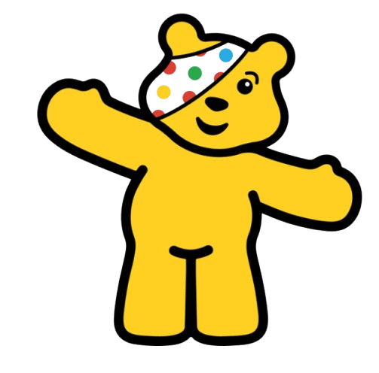

Slide 2










Notes:
Money is raised for mental health services for young people, youth clubs and services (these link to good wellbeing) and families in crisis – what does crisis mean

Slide 3
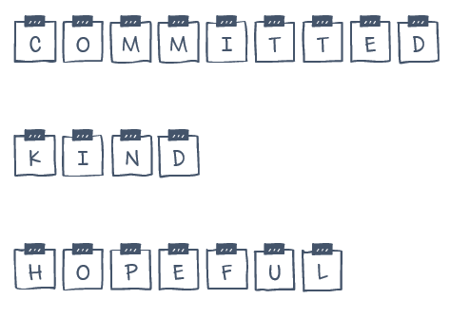
Notes:
Pudsey represents these three words. Like us at Polehampton …

Slide 4

Notes:
What are we committed to? How do we show commitment? How to we show kindness? How do we show hope?

Slide 5



