Slide 1





ANTI-BULLYING WEEK
HOW CAN WE BE GOOD FRIENDS?

Slide 2

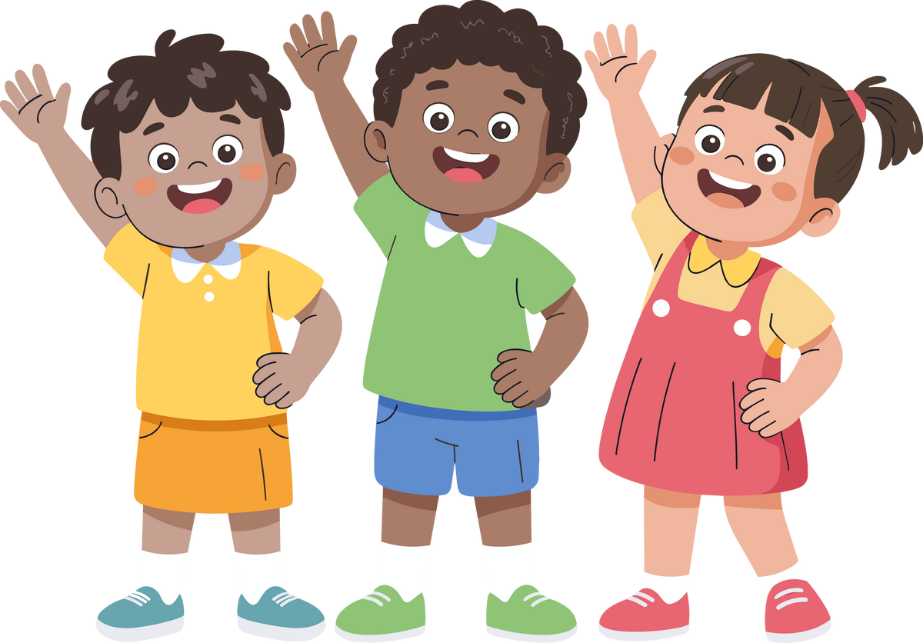
OUR VALUE IS FRIENDSHIP
To be a good friend, you need to be kind, helpful, fair and try to understand how people are feeling. You also need to consider what they want to do.
Day 1

Slide 3
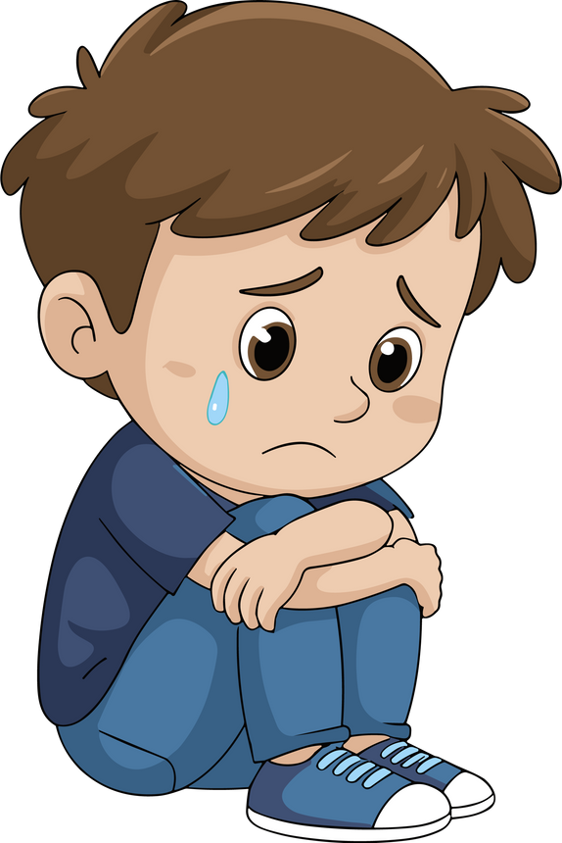
Lots of different things influence how people are feeling. The thing you can control is how you act towards people. It is so important to be kind.
We will never know what other people experience.
Day 1

Slide 4

WHAT IS BULLYING?
S - Several | T - Times | O - On | P - Purpose
STOP
Day 1

Slide 5
What do you think?
Someone repeatedly says you are not allowed to part of their game or that you are not allowed to work with them.
Is that bullying? Is it ever ok?
Day 1
Notes:
Highlight 'keeps'
What are the reasons they might not want you to play?
Is there ever a time where that's ok?

Slide 6
ANTI-BULLYING WEEK
HOW CAN WE BE GOOD FRIENDS?

Slide 7
OUR VALUE IS FRIENDSHIP
Bullying is when someone keeps being unkind, or hurting you, on purpose. They might be making games difficult to enjoy or they might be acting dangerously towards you. It happens again and again and it does not STOP when you ask them to.
Day 2

Slide 8
OUR VALUE IS FRIENDSHIP
Kindness can prevent bullying before it starts.
Smile, share and include others.
Sometimes people are unkind when they are not happy.
Day 2

Slide 9
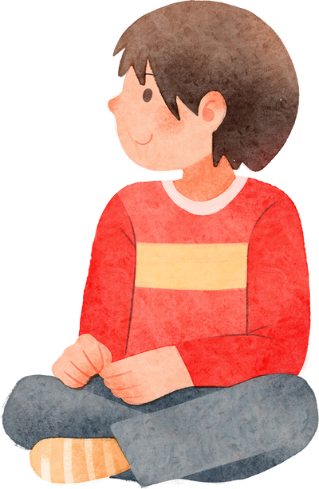
What do you think?
You see someone sitting alone at playtime. They tell you that they are fine.
What would you do in this situation?
You hear someone making comments about them sitting on their own.
What would you do if you heard this?
Is this bullying?
Day 2
Notes:
They tell you that they are fine - some children are
What if they look sad - how do we know they feed sad?
Get the children to consider that some children are happy to decompress at playtimes without other people. It is important to check in on them and make judgements based on their body language/facial expressions etc.
Some children feel calm and happy when they have quiet time by themselves. It helps their brains feel safe and settled. For some children, especially those who are autistic or whose bodies get overwhelmed easily, playtime can feel very busy, loud, or confusing. Having time alone helps them regulate (that means helping their body and feelings get back to a comfortable level).
Being alone doesn’t always mean someone is lonely or sad. It might just mean they’re looking after themselves in the way that works best for their brain.

Slide 10
ANTI-BULLYING WEEK
HOW CAN WE BE GOOD FRIENDS?

Slide 11
OUR VALUE IS FRIENDSHIP
Friendships have ups and downs. That is very normal.
It is important to listen to what your friends want and feel comfortable with.
It is also important to say no if you need to.
Day 3
Notes:
Think about the importance of saying no to something you don't want to - and the importance of accepting that!

Slide 12
OUR VALUE IS FRIENDSHIP
Years 3 and 4
What are some unkind things people do? Why might they do them?
Years 5 and 6
What are some of the down times in friendships?
Day 3

Slide 13
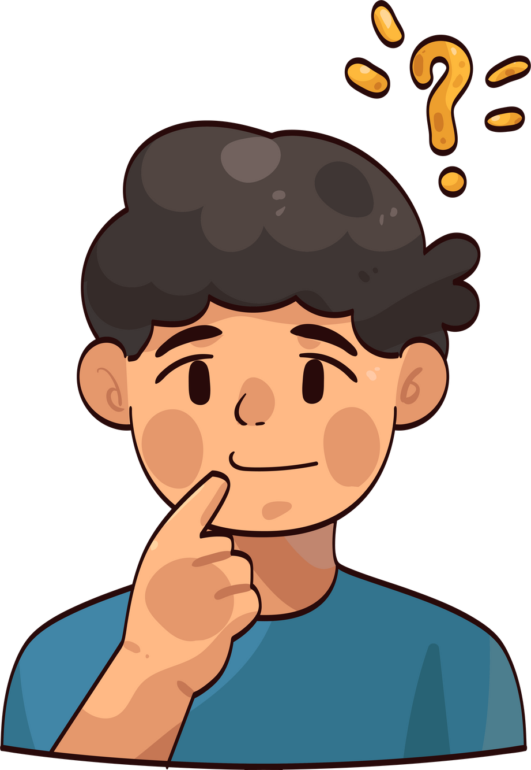
What do you think?
You see someone push someone. The person being pushed is laughing.
What would you do?
Day 3
Notes:
Pushing once is not bullying - discuss

Slide 14
ANTI-BULLYING WEEK
HOW CAN WE BE GOOD FRIENDS?

Slide 15
OUR VALUE IS FRIENDSHIP
It is important that we tell someone when we are not happy with something someone is doing to us. Telling is the first part of fixing.
Day 4

Slide 16
OUR VALUE IS FRIENDSHIP
A friend has given you (or a friend) a nickname based on something you are unable to change. You are ok with the nickname but are worried it might upset other people.
Day 4
Notes:
Crying indicates what? Discuss
Is it ok if someone likes it?
What should the other friend do?

Slide 17
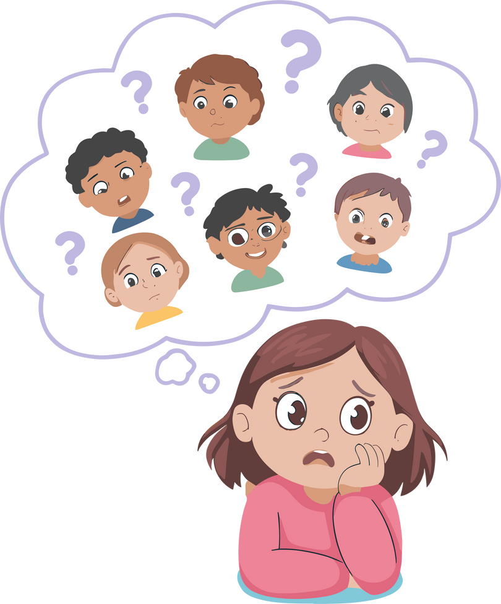
What do you think?
Is this an example of bullying?
What is the red-line in this example? What is not ok here?
What is the best way to solve it?
Day 4
Notes:
Thinking about protected characteristics
hair
race
religion
health
neurodiversity
someone is ok with it but it might offend someone else (So a red line = not sensible)

Slide 18
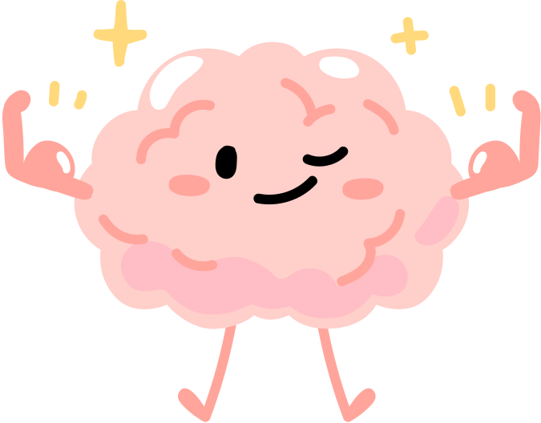
OUR VALUE IS FRIENDSHIP
You might be ok with something that others are not.
Tell someone if you are not ok with something.
Day 4
Notes:
Being assertive not bossy
Expressing feelings - v.important

Slide 19
ANTI-BULLYING WEEK
HOW CAN WE BE GOOD FRIENDS?

Slide 20

OUR VALUE IS FRIENDSHIP
We all need to work together to stop bullying.
Day 5

Slide 21
OUR VALUE IS FRIENDSHIP
If you are feeling lonely or unhappy.
Tell an adult.
If you someone is being unkind to you and has not stopped when you have asked them to.
Tell an adult.
If you see someone being unkind.
Tell a an adult.
Day 5

Slide 22
SOME ‘ONE OFF’ EXAMPLES AS SERIOUS AS BULLYING
If someone could get physically hurt..
If it is about about race (skin colour), religion (beliefs), disability or neurodivergence (what people need to help them), sexuality (who people love) or gender.
Day 5

Slide 23
OUR VALUE IS FRIENDSHIP
Use Compassion
If we are all having happy playtimes and being mindful of other people, people are less likely to be unkind. Look out for other people. Think how your actions may effect others.
People can do unkind things and not realise it can be upsetting. They need to be told, calmly and politely. If they carry on doing it, adults need to know.
Day 5
Notes:
Importance of being calm and polite - not 'getting their back up' and them being defensive, they are less likely to listen

Slide 24
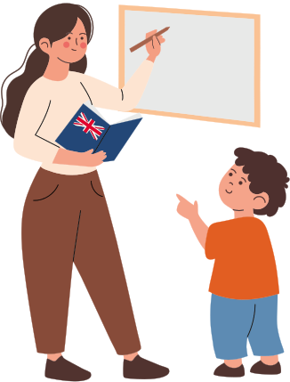
S T O P
Tell
Day 5

Slide 25

Do to others as you would have them do to you.
Luke 6:31

