Slide 1





ANTI-BULLYING WEEK
HOW CAN WE BE GOOD FRIENDS?

Slide 2


OUR VALUE IS FRIENDSHIP
To be a good friend, you need to be kind, helpful, fair and try to understand how people are feeling.
Day 1

Slide 3
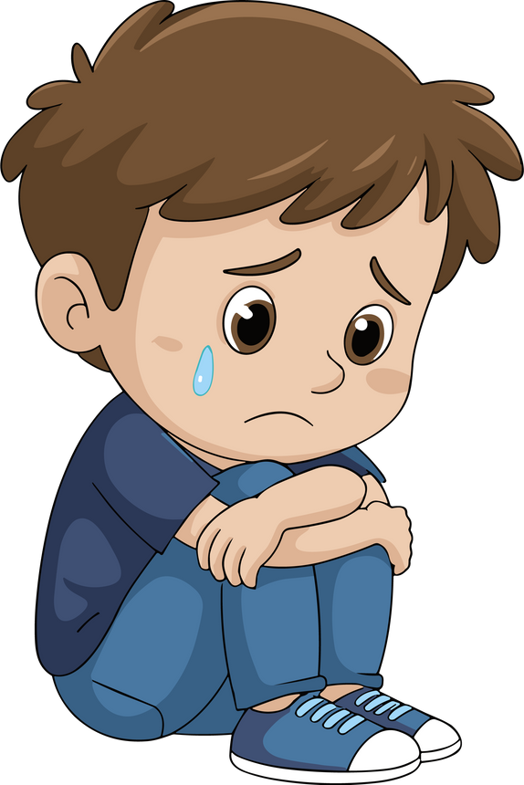
When this doesn’t happen, it makes people feel sad or lonely.
Day 1

Slide 4

WHAT IS BULLYING?
S - Several | T - Times | O - On | P - Purpose
STOP
Day 1
Notes:
Several - more than twice.
For argument's sake - we'll say between 3 - 5

Slide 5
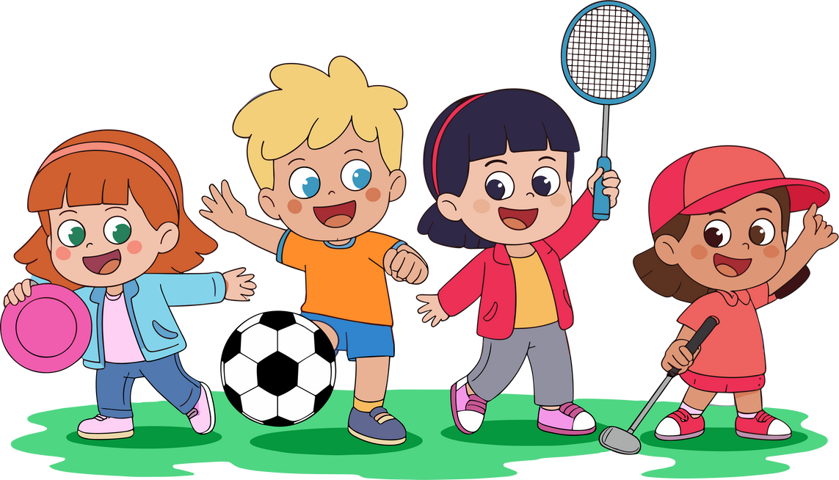
What do you think?
Someone keeps saying you can’t play with them. Is that bullying? What would you do if you saw it?
Day 1
Notes:
Highlight 'keeps'
What are the reasons they might not want you to play?
Is there ever a time where that's ok?

Slide 6
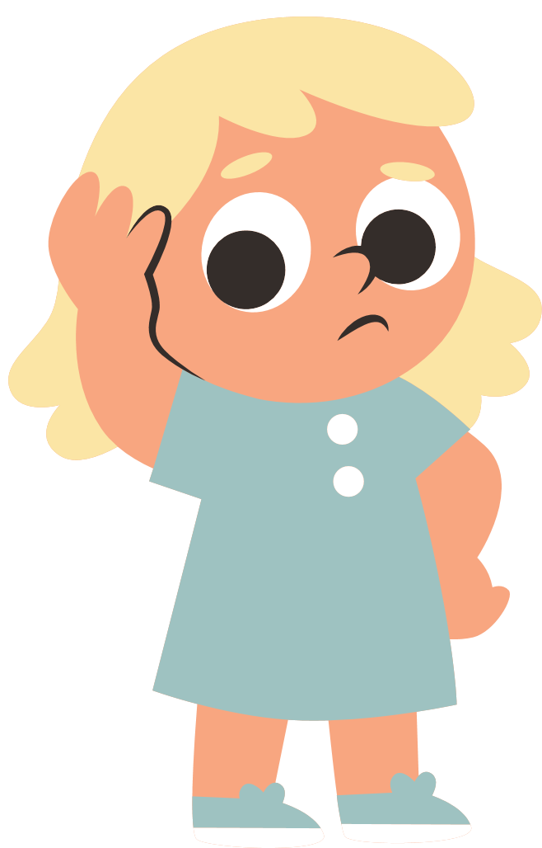
What do you think?
Someone saying you can’t play with them.
Is that bullying?
Day 1
Notes:
Talk about the difference between one off acts of unkindness (we are learning, it's not okay but bullying is when it is repetitive) and several times on purpose

Slide 7
ANTI-BULLYING WEEK
HOW CAN WE BE GOOD FRIENDS?

Slide 8
OUR VALUE IS FRIENDSHIP
Bullying is when someone keeps being unkind on purpose. It happens again and again and it doesn’t STOP when you ask.
Day 2

Slide 9
OUR VALUE IS FRIENDSHIP
Kindness can STOP bullying before it starts. Smile, share and include others. Sometimes people are unkind when they are not happy.
Day 2

Slide 10
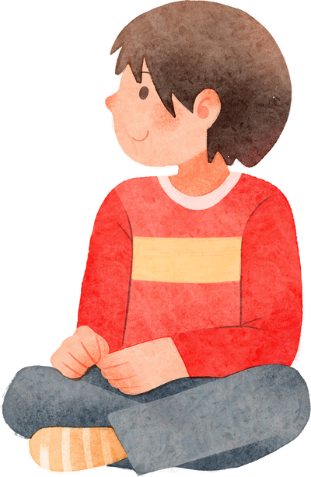
What do you think?
You see someone sitting alone at playtime. They tell you that they are fine. What would you do?
Day 2
Notes:
They tell you that they are fine - some children are
What if they look sad - how do we know they feed sad?

Slide 11
ANTI-BULLYING WEEK
HOW CAN WE BE GOOD FRIENDS?

Slide 12
OUR VALUE IS FRIENDSHIP
If someone won’t STOP being unkind, after you have told them - tell an adult at school and at home. Telling isn’t “telling tales”, it helps to STOP harm.
Day 3
Notes:
Highlight: After you have told them not to - moving away from one of incidents to several times

Slide 13
OUR VALUE IS FRIENDSHIP
What are some unkind things people do?
Why do you think they do them?
Day 3

Slide 14
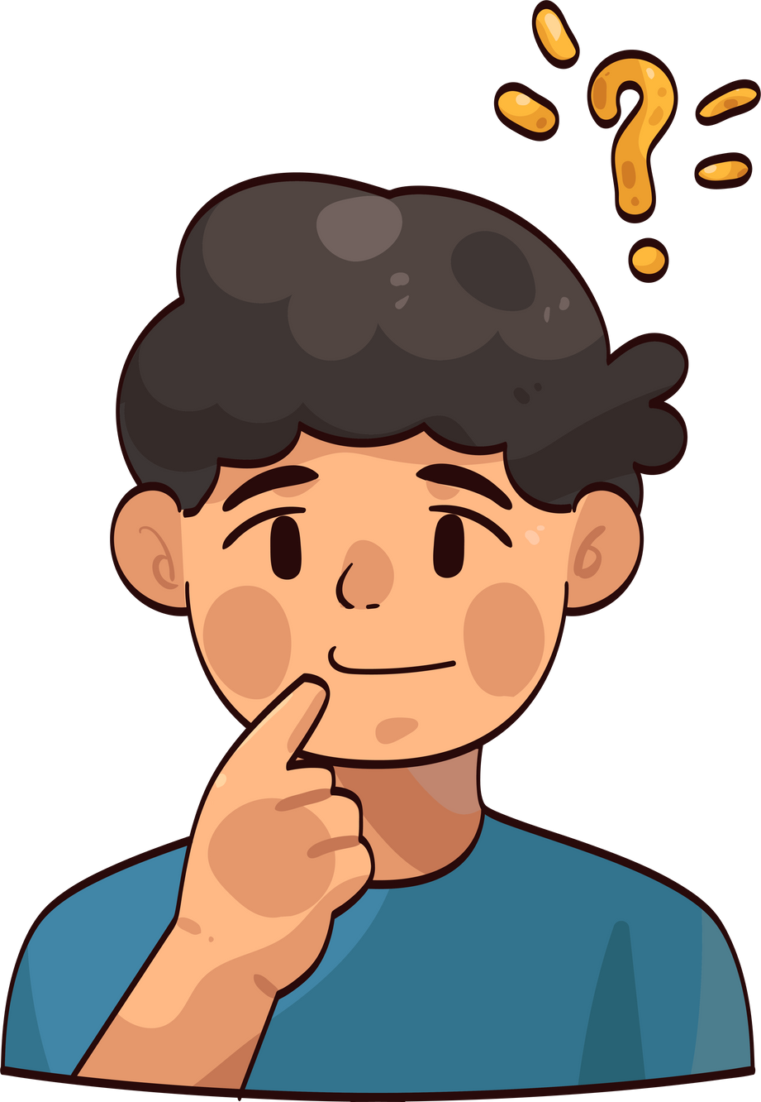
What do you think?
You see someone push someone.
What would you do?
Do you think this is bullying?
Day 3
Notes:
Pushing once is not bullying - discuss

Slide 15
ANTI-BULLYING WEEK
HOW CAN WE BE GOOD FRIENDS?

Slide 16
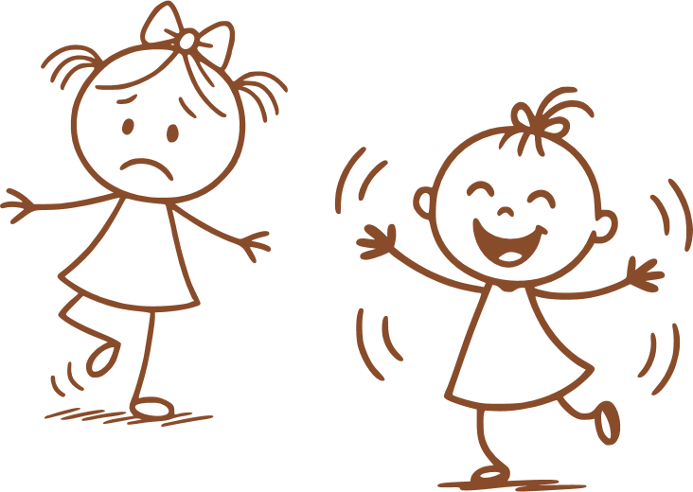
OUR VALUE IS FRIENDSHIP
It is important that we tell someone when we don’t like something someone is doing to us.
Day 4
Notes:
Draw the children's attention to both children being happy
It's not ok if just one person is happy

Slide 17
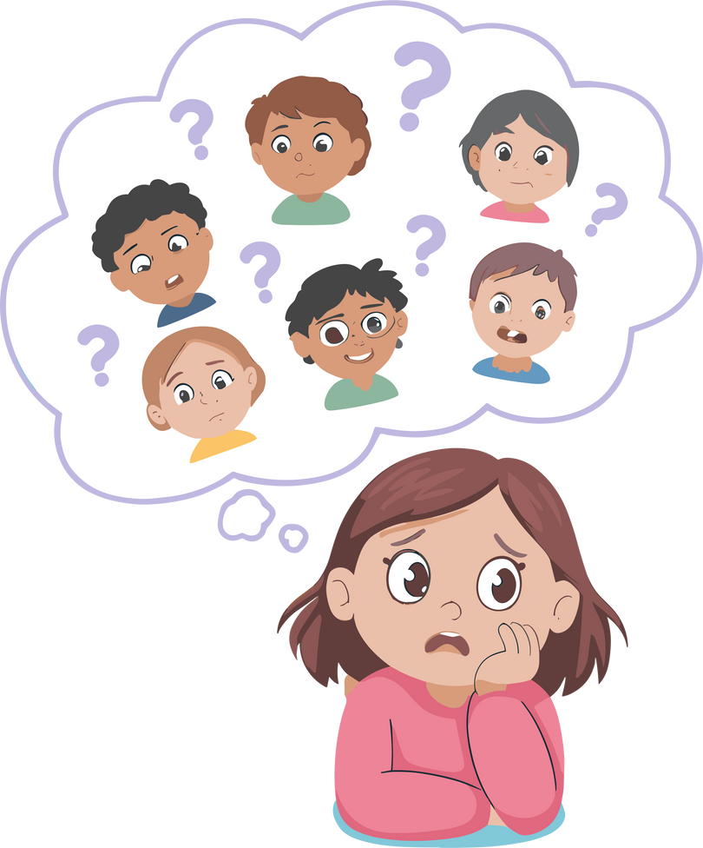
What do you think?
What do you think you should do/say if someone is doing something that makes you upset - even if it is a friend.
Day 4
Notes:
Friends shouldn't treat you badly, that means they are not being a good friend

Slide 18
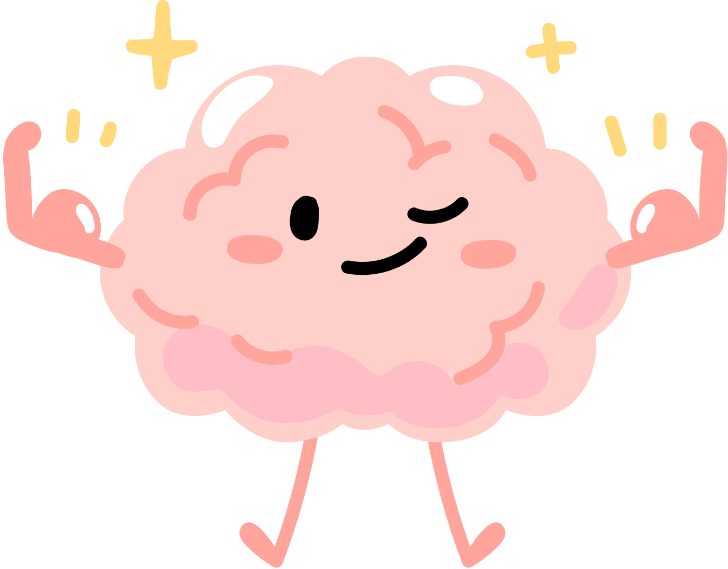
OUR VALUE IS FRIENDSHIP
“I don’t like when you ...”
“It makes me feel embarrassed when you ...”
“I would like you to stop ...”
“Let’s ask an adult to help us.”
Day 4
Notes:
Being assertive not bossy
Expressing feelings - v.important

Slide 19
ANTI-BULLYING WEEK
HOW CAN WE BE GOOD FRIENDS?

Slide 20
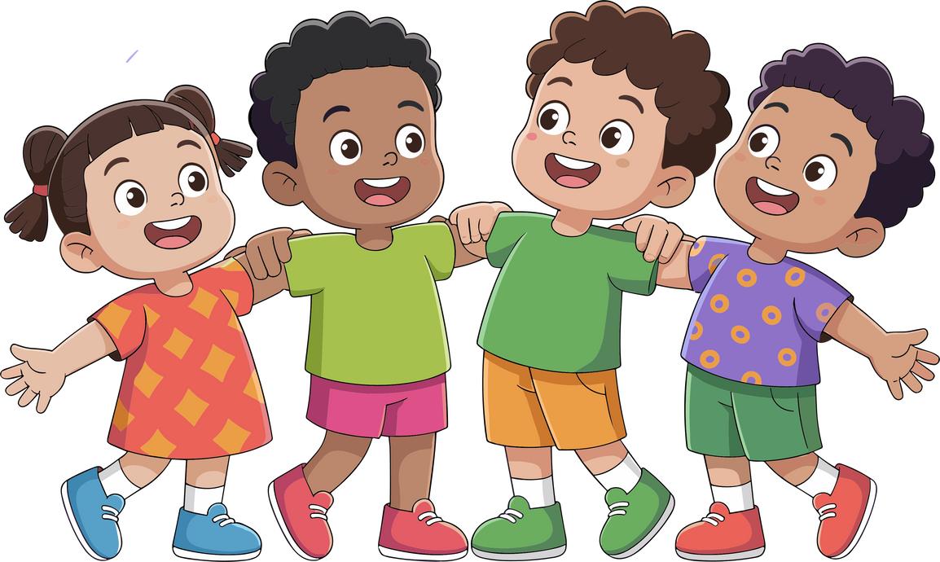
OUR VALUE IS FRIENDSHIP
We can all help to STOP bullying.
Day 5

Slide 21
OUR VALUE IS FRIENDSHIP
If you are feeling lonely or unhappy.
Tell an adult.
If you someone is being unkind to you and won’t stop when you ask.
Tell an adult.
If you see someone being unkind.
Tell a an adult.
Day 5

Slide 22
OUR VALUE IS FRIENDSHIP
Use Compassion
If we are all having happy playtimes, people are less likely to be unkind. Look out for other people.
Ask for Help
People can do unkind things and don’t realise it can be upsetting. They need to be told. If they carry on doing it, adults need to know.
Day 5

Slide 23
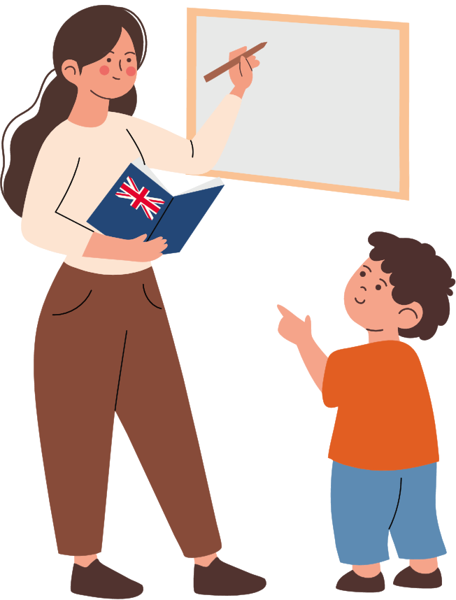
S T O P
Tell
Day 5

Slide 24

Do to others as you would have them do to you.
Luke 6:31

