Slide 1
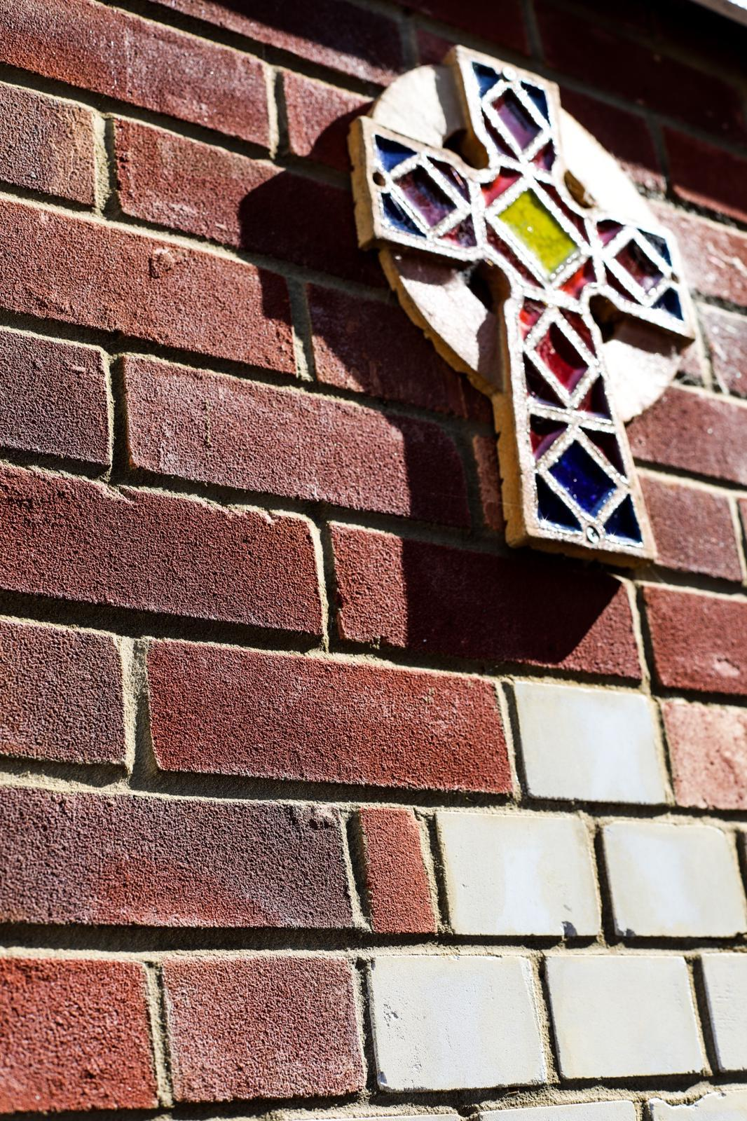

Our Polehampton School
Prayer
Thank you Lord for this new day
Please keep us safe as we learn and play
Help us to be fair and kind
And always keep you in our mind.
Amen

